Slide 1


Department of Computer Engineering ATM and Cellphone Technology Delivered By: Shantanu Potdar
Class R. No:342 PRN No:2046491245042

Slide 2
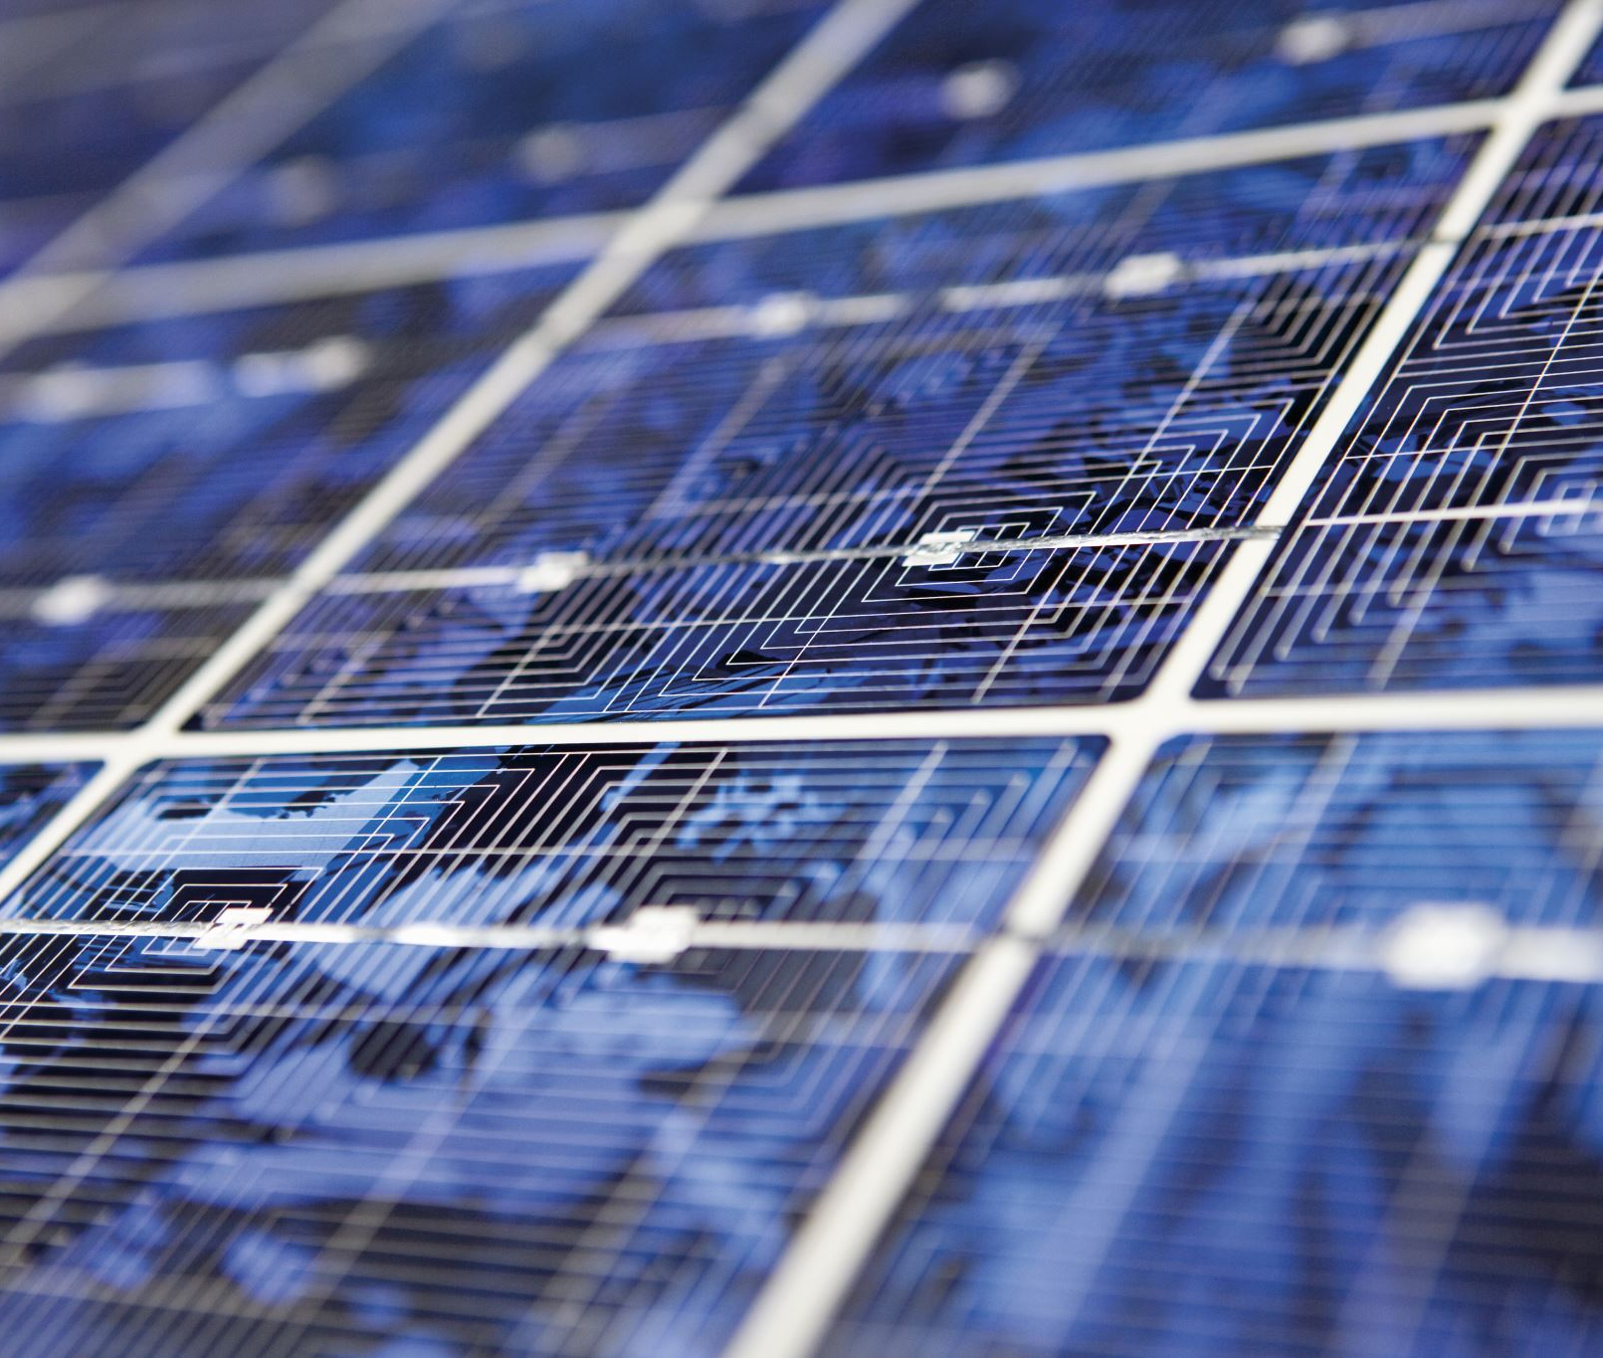
ATM

Slide 3

Introduction to ATM
An ATM, or automated teller machine, is a device that allows customers of financial institutions to perform transactions without the need for a human teller. The first ATM was introduced in the 1960s and has since become a common sight in many countries around the world.
ATMs provide a convenient way for customers to withdraw cash, check their account balances, transfer funds between accounts, and even deposit checks or cash. They are available 24 hours a day, seven days a week, making banking more accessible than ever before.

Slide 4

How ATM Work
When a customer inserts their debit or credit card into an ATM, the machine reads the information on the magnetic stripe or chip. The customer then enters a personal identification number (PIN) to access their account.
The ATM communicates with the customer's bank to verify their identity and account information. Once verified, the customer can select the transaction they wish to perform and the ATM dispenses cash or completes the requested function.

Slide 5

Security Measures in ATM
ATMs are designed with various security measures to protect against fraud and theft. One such measure is the use of encryption to protect the customer's personal and financial information during the transaction process.
Other security features include cameras to capture images of users, tamper-evident technology to detect if the machine has been opened or altered, and alarms to alert authorities in case of suspicious activity.

Slide 6
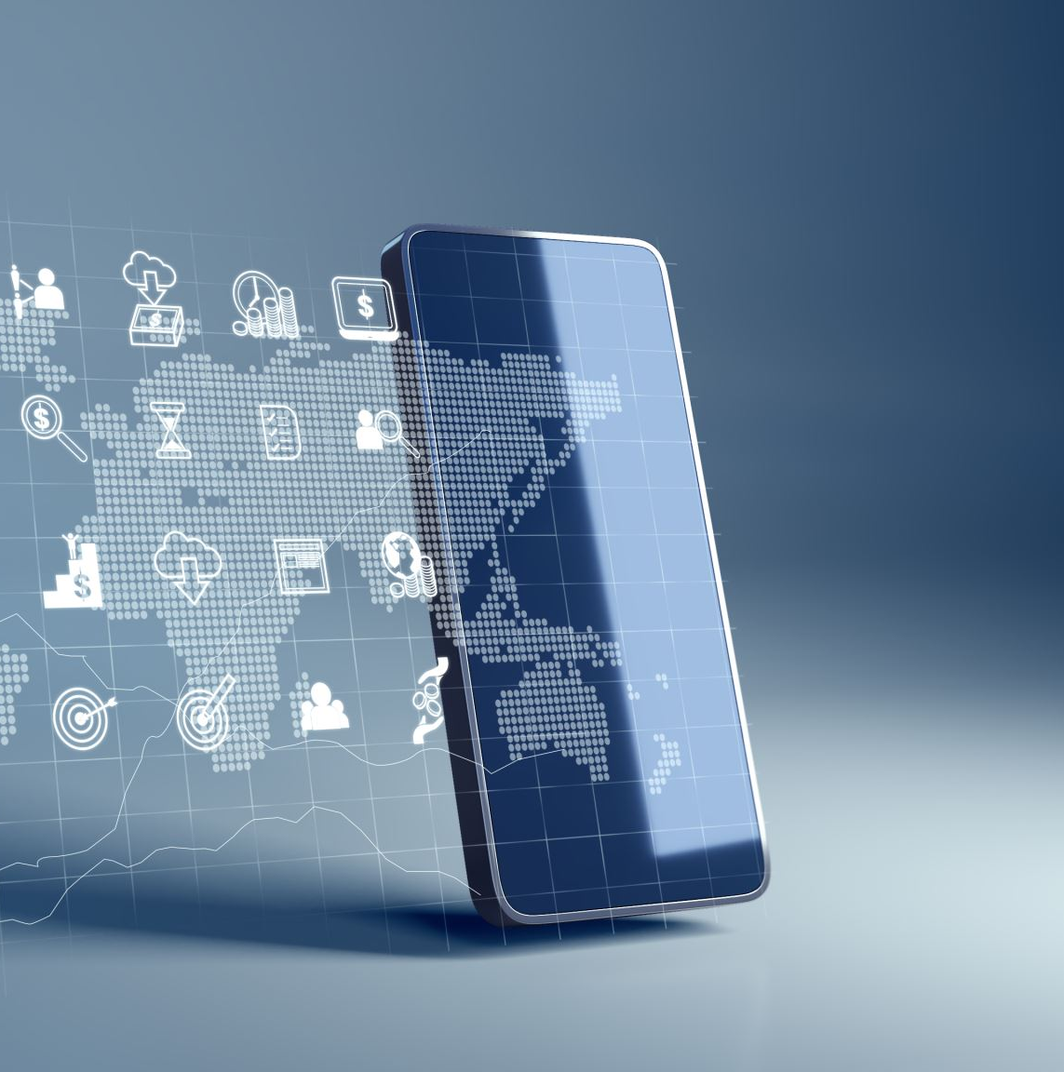
ATM and the Future of Banking
As technology continues to advance, so too do ATMs. Some newer models feature touchscreens, biometric authentication, and even video conferencing capabilities with bank representatives.
ATMs are also becoming more integrated with mobile banking apps, allowing customers to initiate transactions on their smartphones and complete them at the ATM. With these advancements, ATMs are sure to remain a crucial part of the banking industry for years to come.

Slide 7
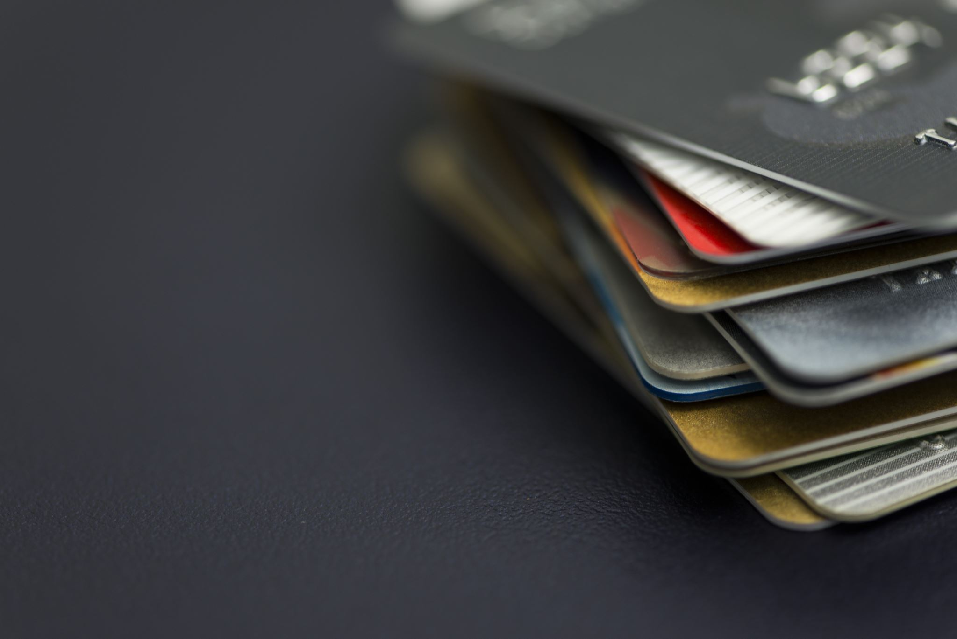
The Benefits of ATM
ATMs provide numerous benefits to both customers and financial institutions. For customers, they offer convenience and accessibility, allowing them to perform transactions at any time of day or night.
For banks, ATMs reduce the need for human tellers, lowering operating costs and increasing efficiency. They also allow banks to expand their reach into areas where they may not have physical branches, making banking services available to more people.

Slide 8
Conclusion
In conclusion, ATMs have revolutionized the banking industry by providing customers with a convenient way to access their accounts and perform transactions. With advanced security measures and continued technological advancements, ATMs will continue to be a vital component of the banking landscape.
Whether you're withdrawing cash from an ATM on a street corner or completing a complex transaction with a video-enabled machine, ATMs are an essential part of our daily lives.

Slide 9
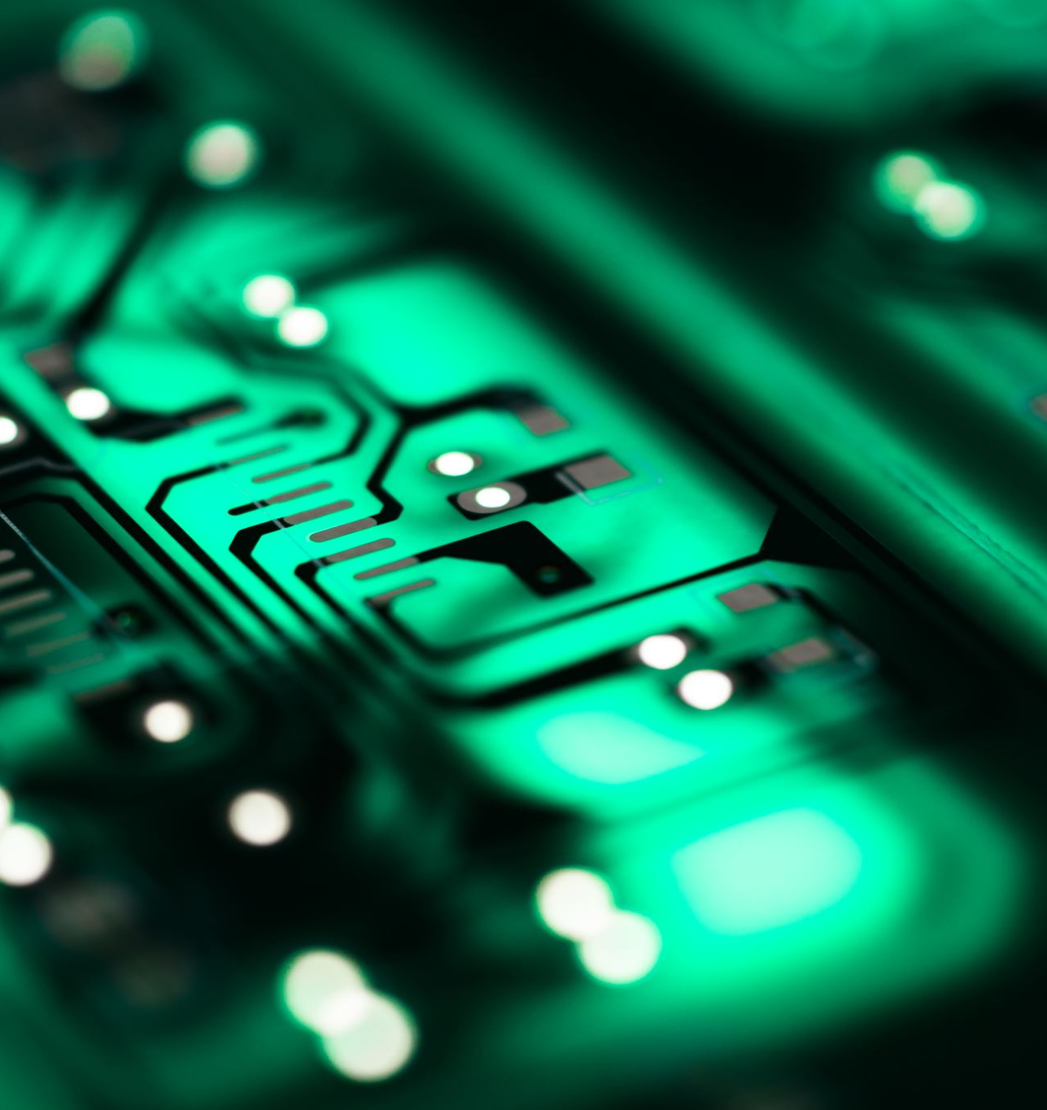
CellPhone Technology

Slide 10

The Evolution of Cellphone Technology
Cellphones have come a long way since their inception. From the bulky, brick-like devices of the 1980s to the sleek, multi-functional smartphones of today, cellphone technology has evolved at an astonishing pace. One of the most significant advancements in cellphone technology was the introduction of touchscreens. This allowed for a more intuitive user experience and opened up new possibilities for app developers.
Another major development in cellphone technology was the integration of high-quality cameras. Today's smartphones are capable of taking stunning photos and videos that rival those taken with professional cameras. This has led to the rise of social media platforms like Instagram and Snapchat, where users can easily share their visual content with the world.

Slide 11

The Impact of Cellphone Technology on Society
Cellphone technology has had a profound impact on society. One of the most significant effects has been the way it has changed the way we communicate. With cellphones, we can now stay connected with friends and family no matter where we are in the world. This has made communication faster and more convenient than ever before.
Cellphones have also transformed the way we consume media. We can now access news, entertainment, and information at any time and from anywhere. This has led to the rise of social media influencers, who can reach millions of people with a single post. Additionally, cellphones have made it easier for us to shop online, stream music and movies, and even order food delivery.

Slide 12
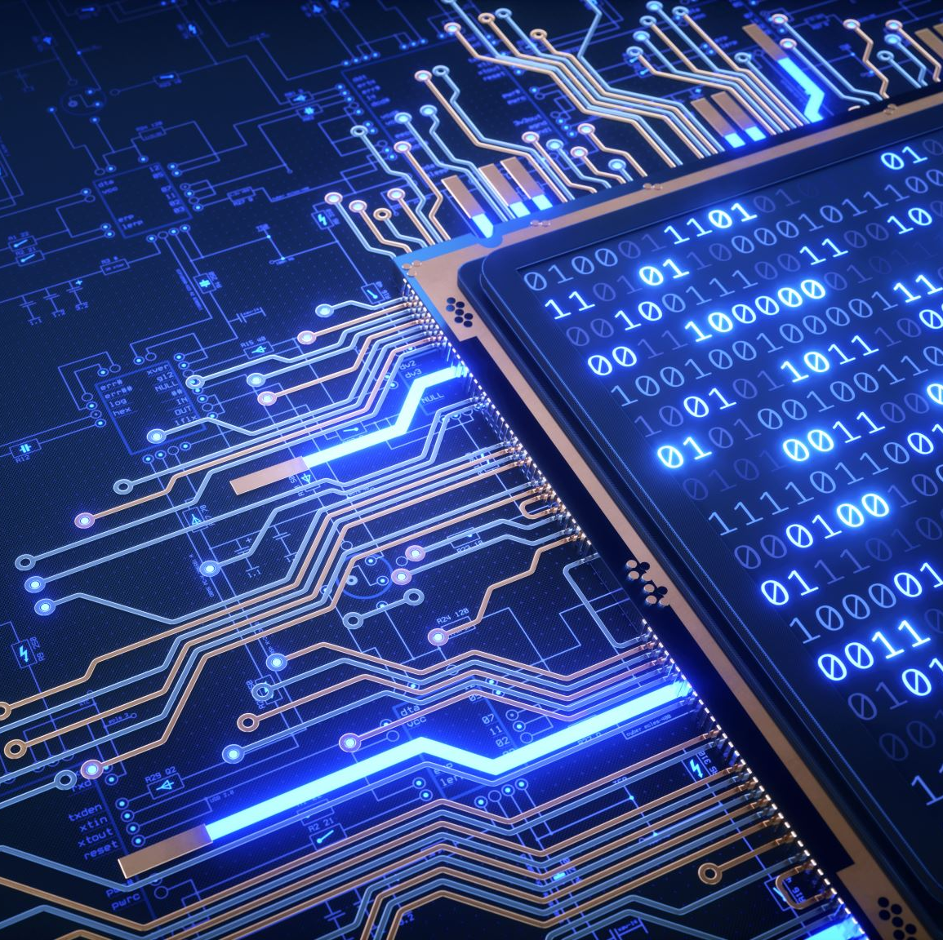
The Future of Cellphone Technology
As technology continues to advance, so too will cellphone technology. One of the most exciting developments on the horizon is the advent of 5G networks. This will allow for even faster download and upload speeds, making it possible to stream high-quality video and play online games without any lag.
Another area of innovation in cellphone technology is augmented reality (AR). AR allows users to superimpose digital images onto the real world, creating a new layer of interactivity and engagement. This technology has already been used in popular apps like Pokemon Go and Snapchat, but its potential applications are virtually limitless.

Slide 13
The design of cellphone
While cellphone technology has brought many benefits, it also has a dark side. One of the most significant negative effects has been the rise of cyberbullying. With the anonymity provided by social media, bullies can harass and intimidate their victims without fear of consequences.
Cellphones have also been linked to a range of health problems, including eye strain, neck pain, and sleep disorders. Additionally, the overuse of cellphones has been shown to contribute to anxiety and depression, particularly among young people.

Slide 14
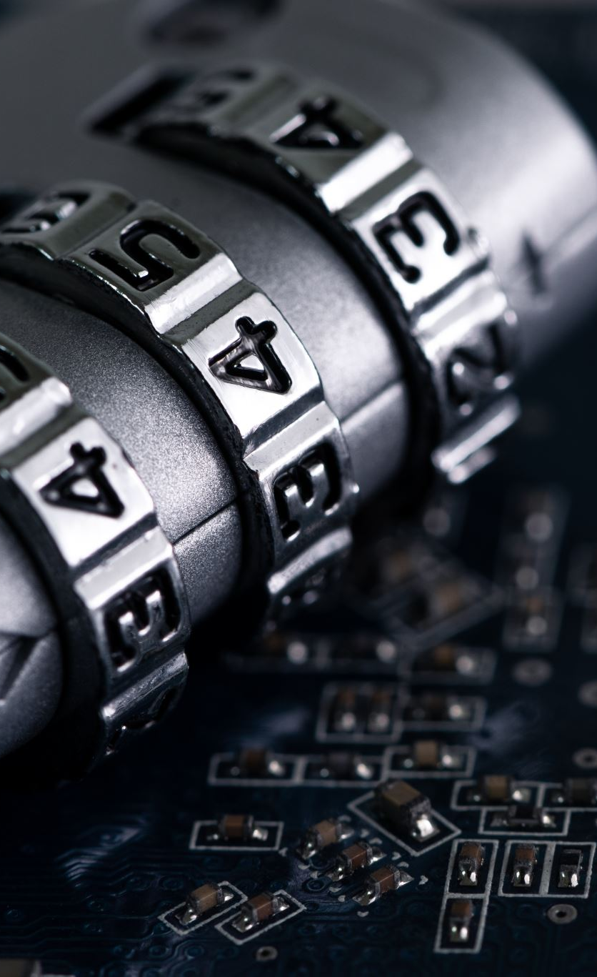
The Ethics of Cellphone Technology
As with any technology, there are ethical considerations surrounding cellphone technology. One of the most pressing issues is privacy. With so much personal information stored on our phones, it's essential that companies take steps to protect our data from hackers and other malicious actors.
Another area of concern is the environmental impact of cellphone production and disposal. The materials used in cellphones are often sourced from conflict zones or environmentally sensitive areas, and the disposal of old phones can lead to pollution and toxic waste. It's important for consumers to be aware of these issues and to make informed choices about the products they buy.

Slide 15

The Role of Cellphone Technology in Education
Cellphone technology has the potential to revolutionize education. With smartphones, students can access educational resources and collaborate with classmates from anywhere in the world. This makes learning more accessible and convenient than ever before.
Additionally, cellphones can be used to gamify learning, making it more engaging and fun for students. Educational apps like Duolingo and Kahoot! have already demonstrated the power of gamification in education, and as technology continues to advance, we can expect to see even more innovative approaches to teaching and learning.

Slide 16

Conclusion
In conclusion, the evolution of cellphone technology has been nothing short of remarkable. From the bulky bricks of the past to the sleek and powerful smartphones of today, cellphones have come a long way. With each new advancement, we have seen new possibilities emerge, from the ability to connect with people across the globe to the potential to revolutionize education.
As we look to the future, it's clear that cellphone technology will continue to play an increasingly important role in our lives. Whether it's through the development of new apps, the integration of artificial intelligence, or the creation of entirely new devices, we can expect to see even more exciting innovations in the years to come.

Slide 17

THANK YOU☺

